Slide 1
Muafer application
Suhaila hawsawi – 2111786 Lama almalki – 2111750
Sara Alharbi – 2110992 Dana alshaikhi - 2111960

Slide 2
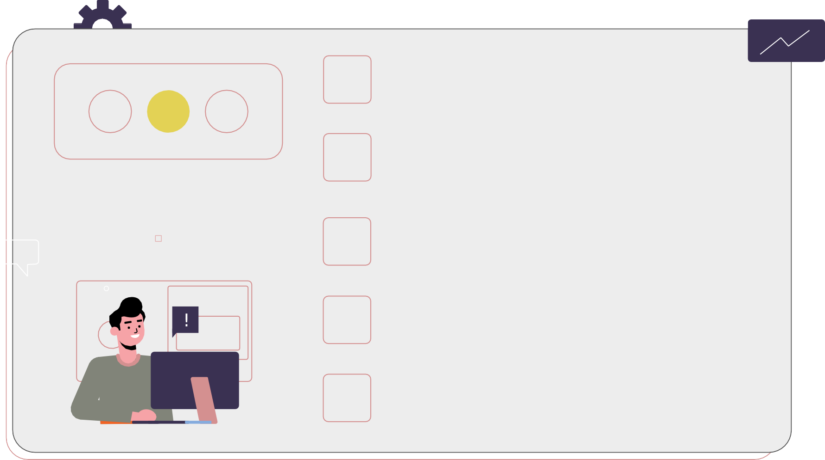
Project Idea
Children’s finance management app
01
$
The methodology
scrum methodology
02
TABLE OF CONTENTS
Project management tool
ASANA
03
The code
Output and the code
04
Faced Problems
Description of challenges
05

Slide 3



Project Idea
$
01
Children’s finance management app
is a financial education app designed especially for kids. The app aims to teach children about money management in a fun and engaging way.

Slide 4

Main functions
registration
Create an account that includes child information
Goals
The child sets an amount to achieve in a given time period
Challenges
The child can challenge his friends to reach a specific financial goal, Moafer will determine the winner at the end of each challenge

Slide 5
Methodology
02

Slide 6
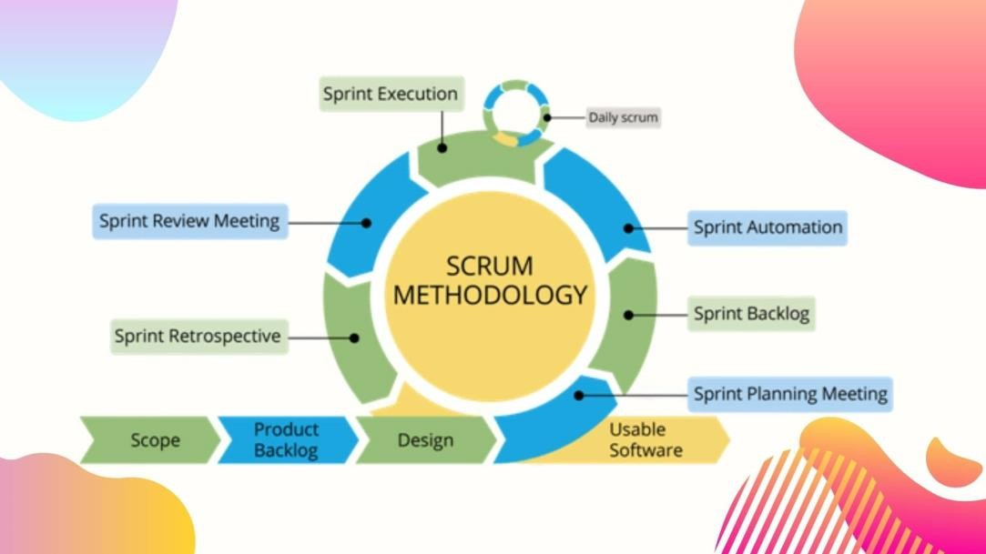
scrum

Slide 7

Why Scrum?
High quality
High productivity
Low cost

Slide 8


Project management tool
03

Slide 9



ASANA
Keep work and goals organized in
one place
Communicate easily
Single Assignee for Tasks

Slide 10
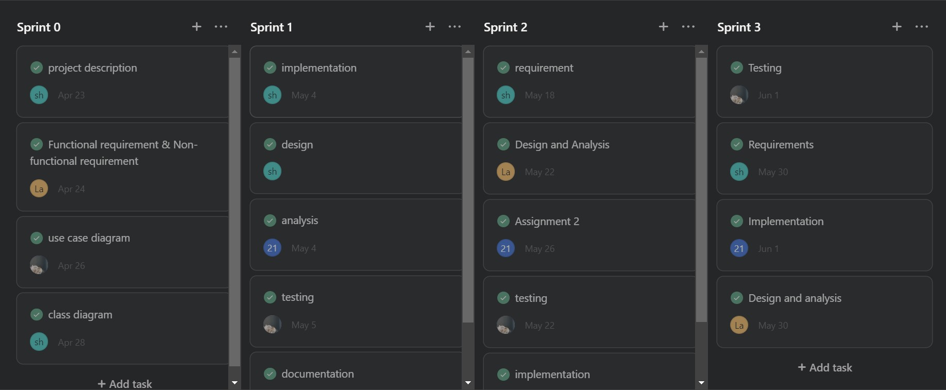

Slide 11
The code
04
Output and the code

Slide 12

Faced Problems
Short time period
Little knowledge
of tools
Many code
errors
Members’
differing opinions

Slide 13
What have we learned?
Manage time effectively and Effective communication.
Directing focus and completing
requirements within a specified deadline.
-Achieving customer satisfaction through
continuous reviews and feedback.

Slide 14
Future plans
Develop muafer
Add new properties
Special character design
Participate in technical forums

Slide 15





WE ARE GRATEFUL FOR YOUR LISTENING!

